Slide 1
WATmonitor
Web Application Transaction Monitor
PerfCap Corporation
76 Northeastern Blvd., Nashua, NH 03062
www.PerfCap.com; Info@PerfCap.com; +1 603 594 0222
© PerfCap Corporation 2013

Slide 2
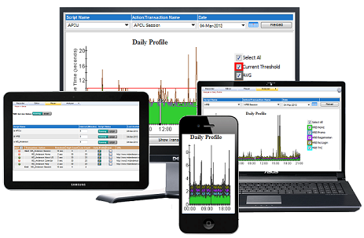
Typical Interactive User Transaction
Response Time
Internet/ Intranet
Interactive Web User
Business Data Center
For each Transaction
24 x 7 Response Time
Trend
Daily Profile
Availability/Uptime
Real Time Alerts
E-Mail Alerts

Slide 3
WAT Monitor
WAT Monitor records, replays and produces web transaction response time reports (for any internet or intranet web site) as a user would experience it at different times of the day.
It provides response time, trends, alerts and web site uptime/availability reports.

Slide 4
WAT Monitor
Record web transactions without writing any code or scripts.
Play recorded actions securely 24x7 or any selected period.
Collect end-to-end web transaction response time for any site or any set of actions.
Analyze performance statistic (Min, Max, Av, trend and site availability) to track SLAs.
Immediate notification when site is down or unacceptable response times are experienced.
Provides immediate review reports and charts on smart devices.
It records your competitions site and compares response time and user experience.

Slide 5
Desktop
WAT
www.dcu.org
Response Time
Internet/ Intranet
www.UrWebSitecom
www.UrWebSite.com
www.Block.com
www.Bank.com

Slide 6
WAT Monitor Example
Sample monitoring of InBank

Slide 7
Interactive Bank (InBank) Monitoring
InBank main web site was monitored between March 27, 2013 and April 16, 2013
Following actions were recorded
Visit InBank home page
Enter User Name to login
Enter Password to login
Logout after successful login
These actions were executed every three minutes and their response time were recorded

Slide 8
InBank Web Site Observations
After monitoring InBank Web site for 20 days the following observations were made:
Almost every day some of the actions will time-out (not necessarily at the same time) – See (p8)
Multiple time-outs were observed during some of the days (p9)
During 20 day period maximum day response time for
Login (User ID) 05.41sec to 58.36sec (p10)
Login Success (Pass Word) 28.43sec to 59.22sec (p11)
Logout 04.39sec to 29.77sec (p12)

Slide 9
InBank Web Site Observations (cont.)
Observations Cont.
During 20 day period Av. response time trend for
Login (User ID) 1.51sec down to 1.36sec (p13)
Login Success (Password) 9.97sec down to 6.93sec (p14)
Logout 1.71sec down to 1.69sec (p15)
Overall InBank Web site availability is shown in p16
Site Uptime ranged between 97.08% to 100%, however site was mostly available during peak hours.
Slide p17 shows response time breakdown during the day (note when response time is above 80 Sec.)

Slide 10
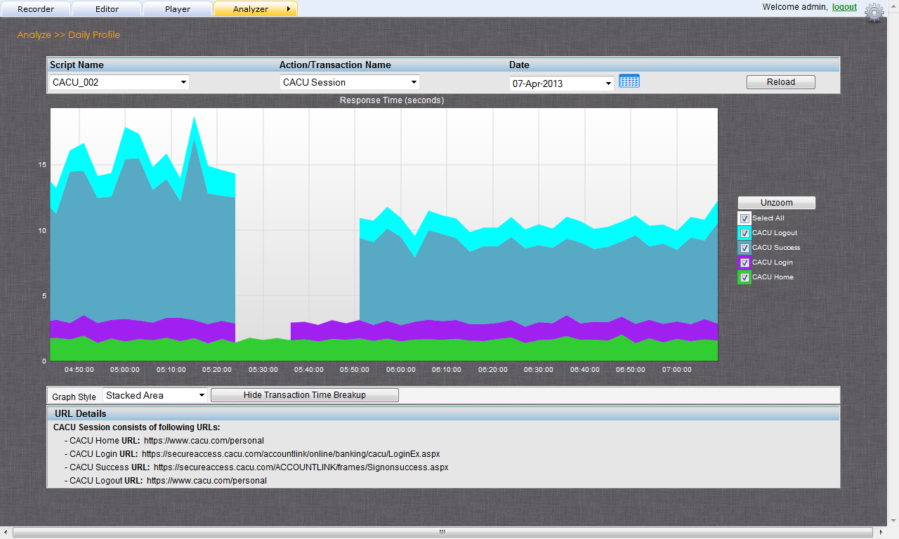
Web Actions Timing out
Login (Password) timed out for 15 min
Login (User Name) timed out for 9 min

Slide 11
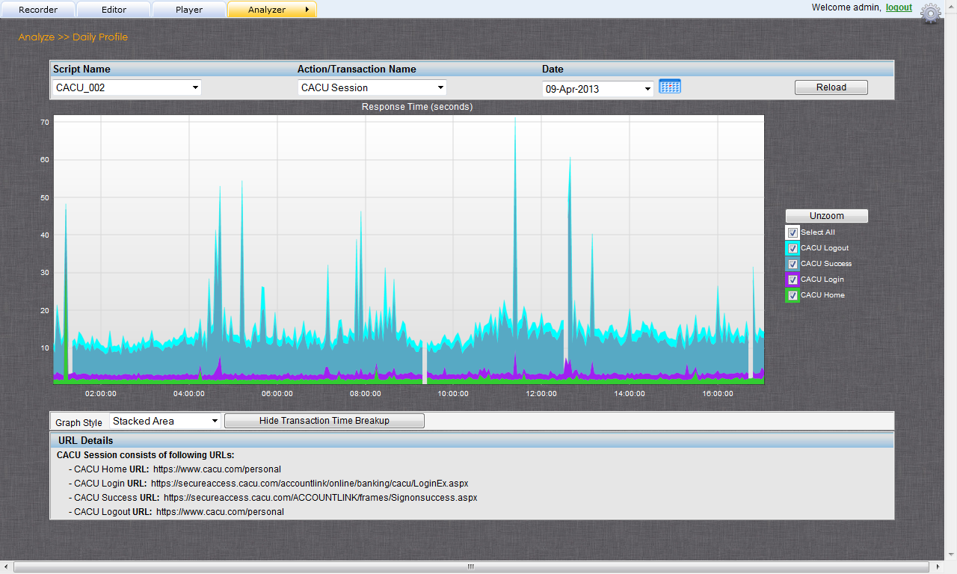
Web Actions Timing out

Slide 12
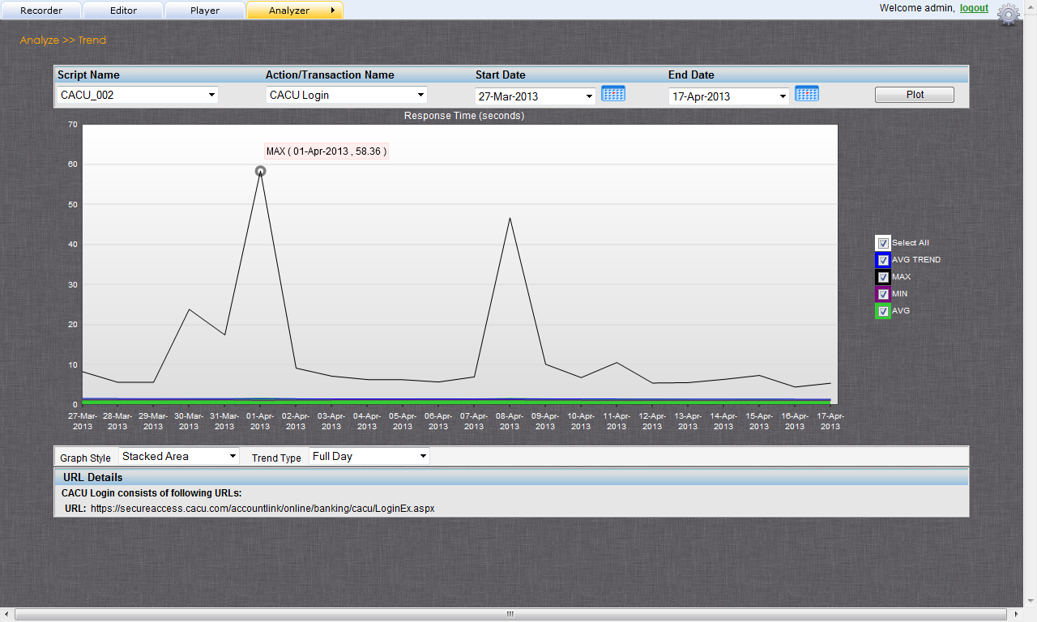
Max Login (User ID) time during the day

Slide 13
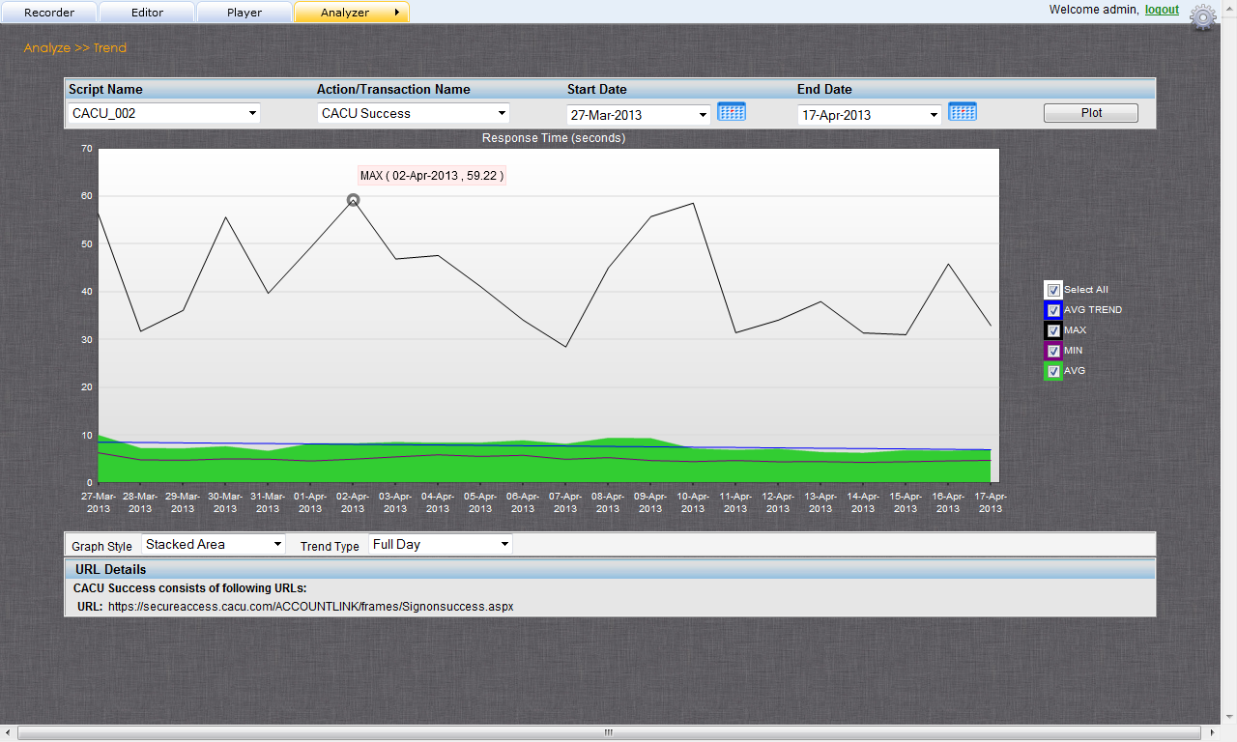
Max Login (Pass Word) time during the day

Slide 14
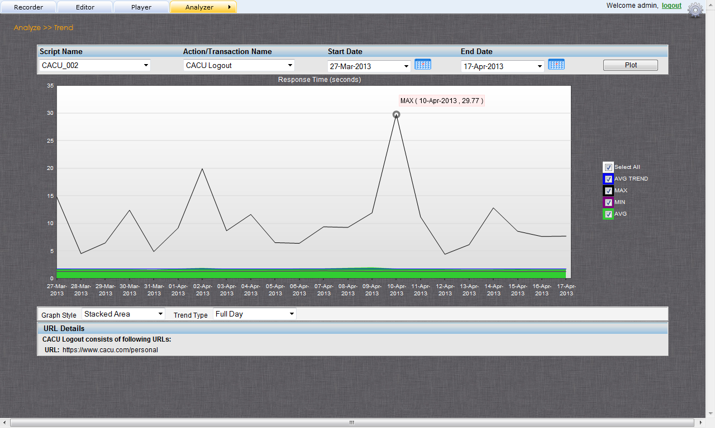
Max Logout time during the day

Slide 15
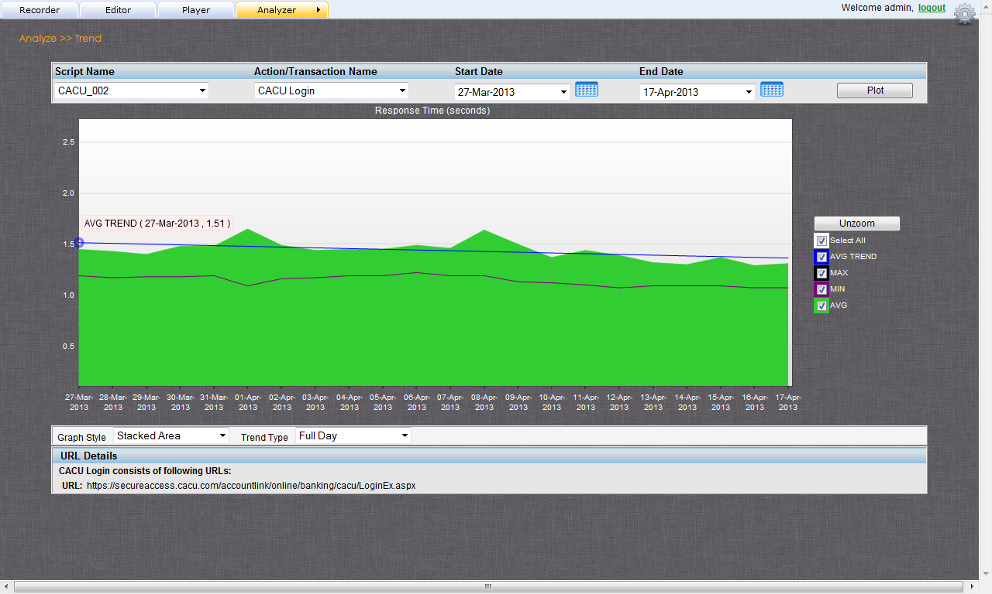
Av. Login (User ID) Trend Time

Slide 16
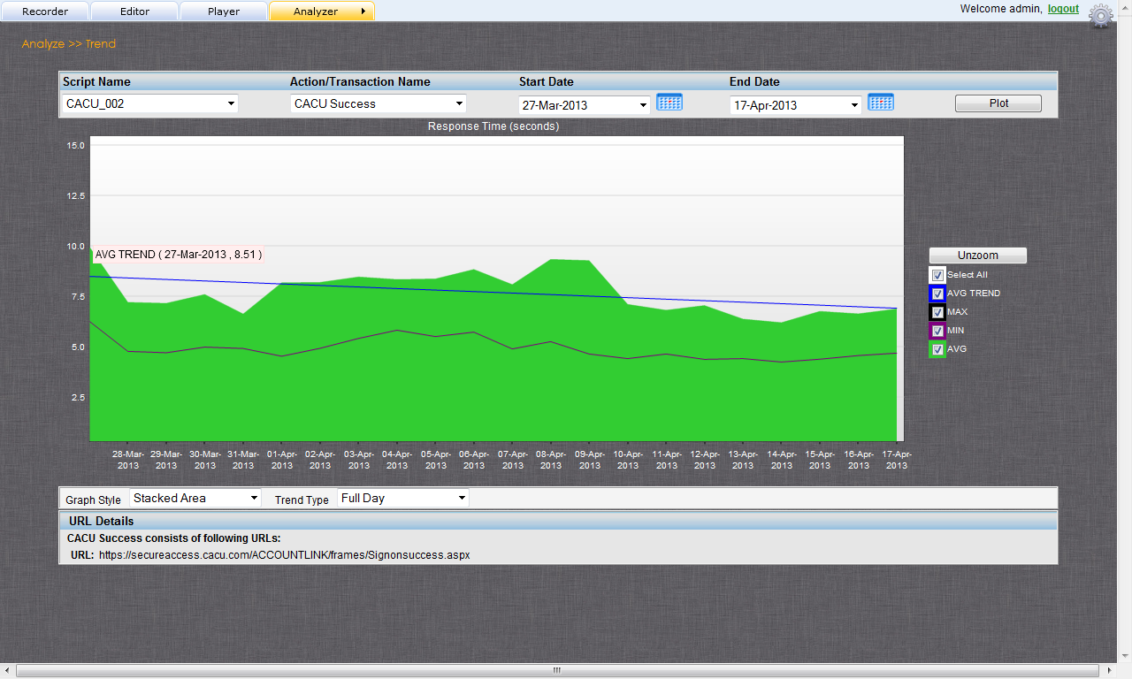
Av. Login (Pass Word) Trend Time

Slide 17
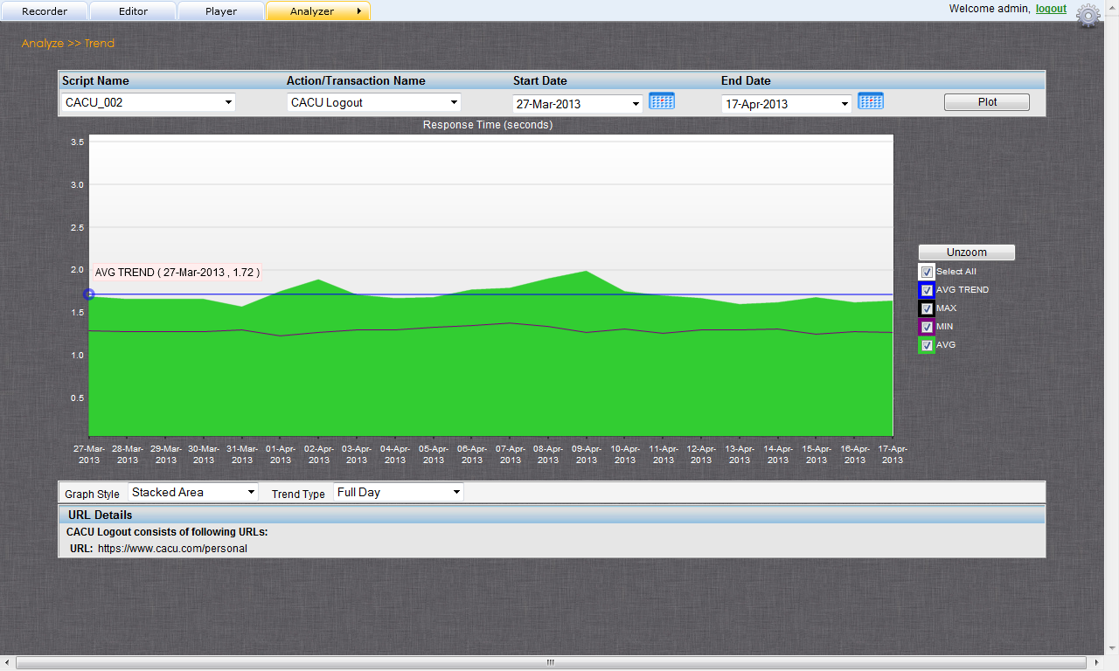
Av. Logout Trend Time

Slide 18
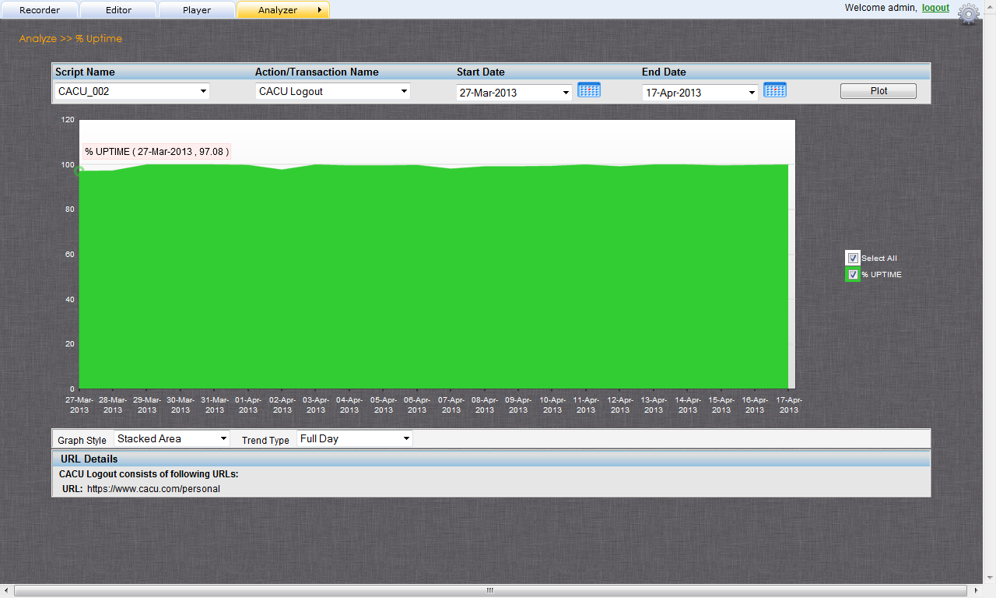
% Uptime

Slide 19
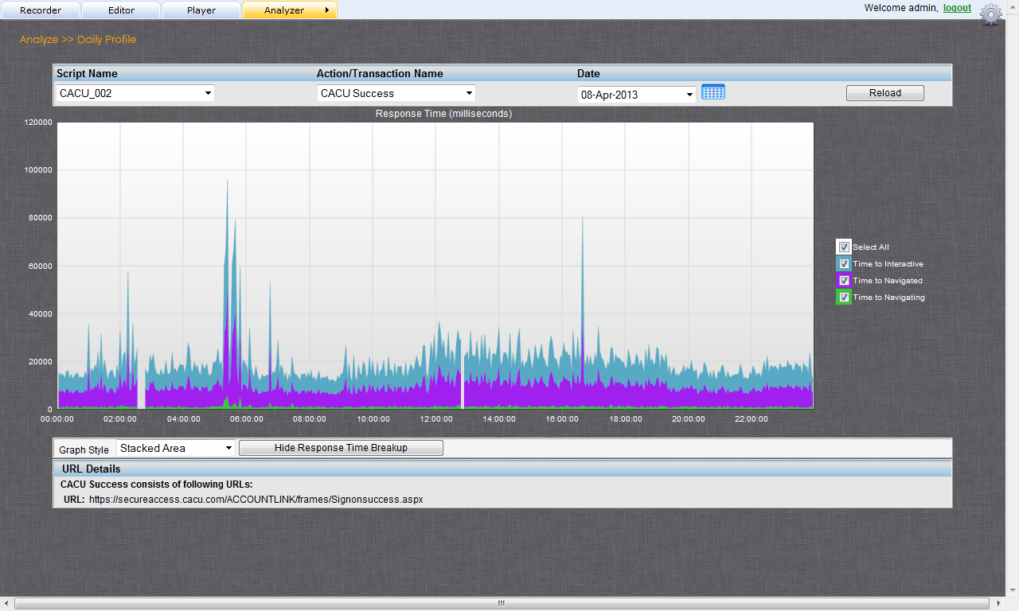
Response Time Breakdown

Slide 20
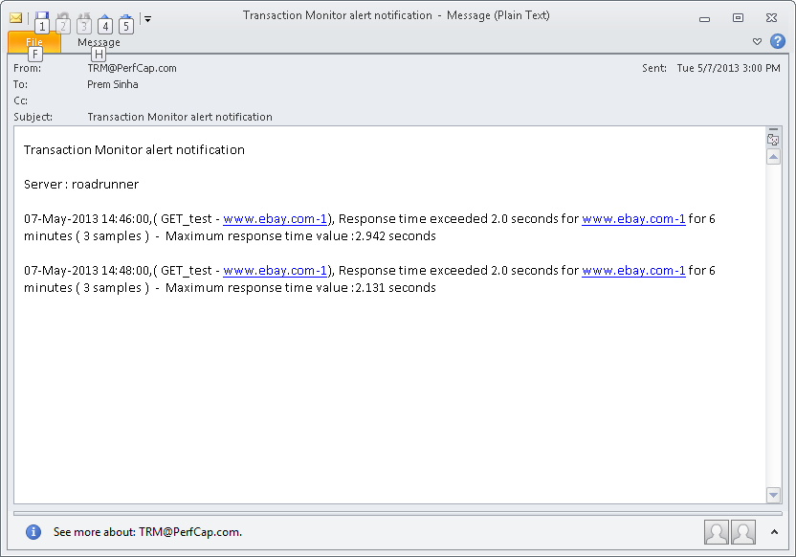
Real-Time E-Mail Notification

Slide 21
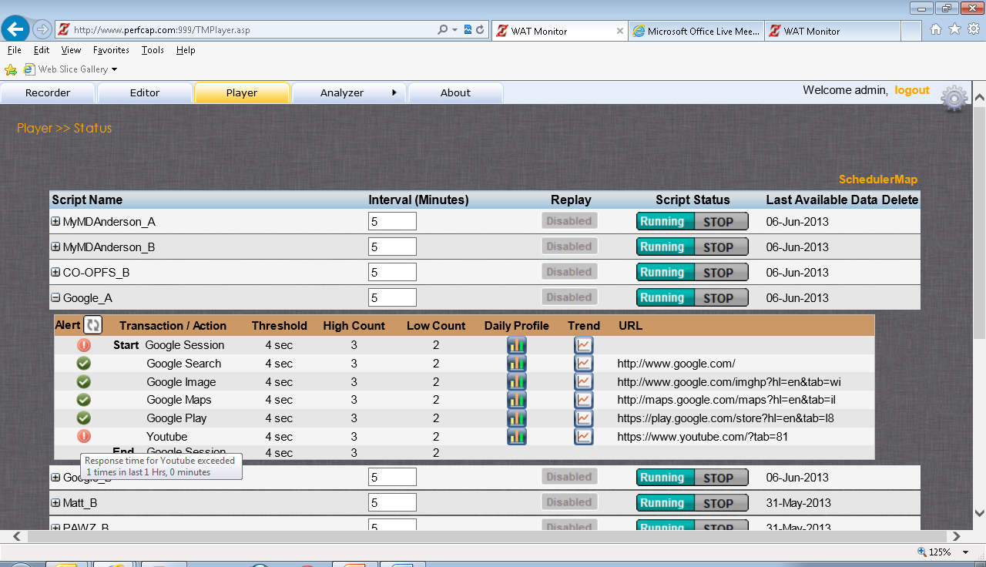
Real Time Status

Slide 22
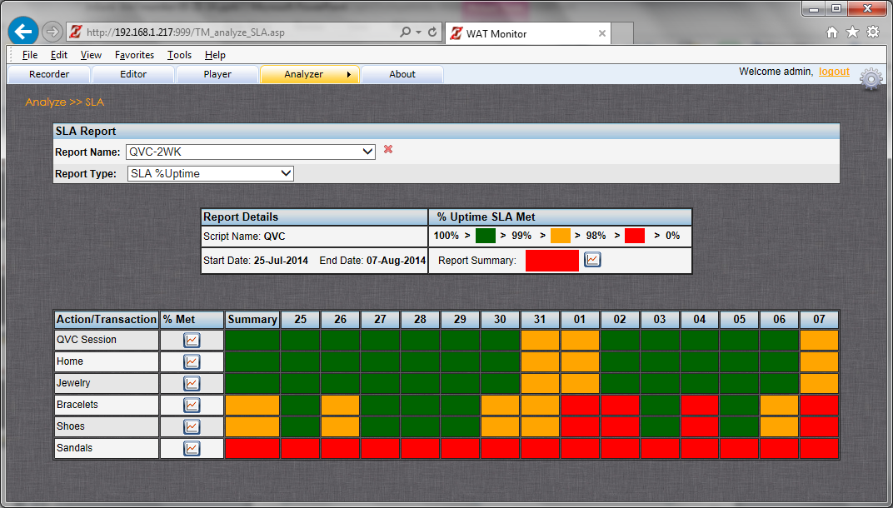
QVC Web Site Uptime SLA

Slide 23
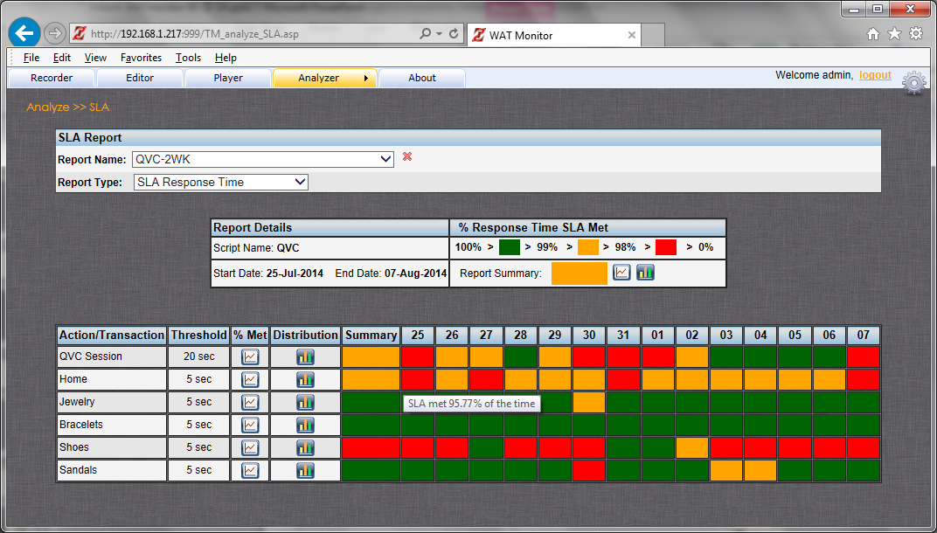
QVC Web Site Response Time SLA

Slide 24
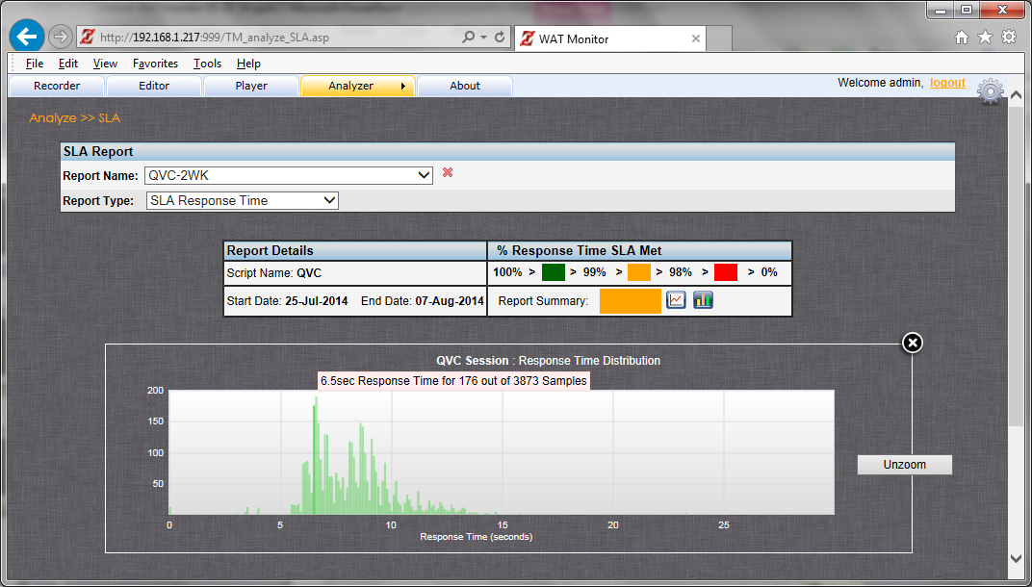
QVC Web Site Response Time Distribution

Slide 25
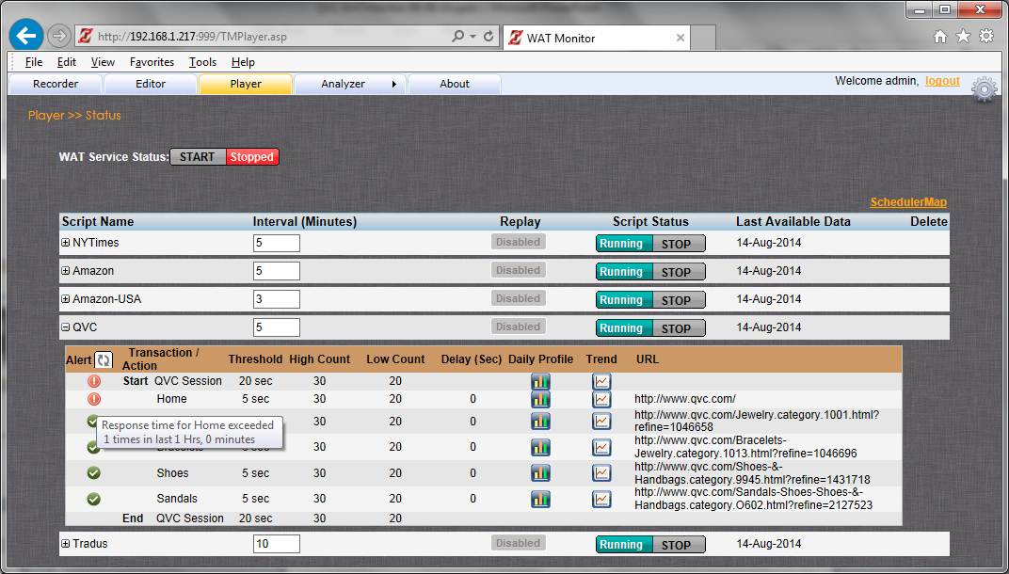
QVC Web Site Real Time Notification

Slide 26
E-Mail Notification

Slide 27
WATmonitor Component
Recorder – Create synthetic Web transactions without writing a script
Player – Play recorder sessions at defined intervals
Analyzer – Analyze and produce reports/graphs
Response Time
Trend
Site Availability
Set: eMail Notification, Frequency etc.,

Slide 28
Real Time and e-mail Alerts
Real Time – exceptions reached within last predefined minutes displayed within Player display
E-mail notifications batched and emailed at predefined intervals

